Slide 1
UNIFORM CIRCULAR MOTION

Slide 2
Circular Motion
In physics, circular motion is a movement of an object along the circumference of a circle or rotation along a circular path. It can be uniform, with constant angular rate of rotation and constant speed or non-uniform with a changing rate of rotation.

Slide 3
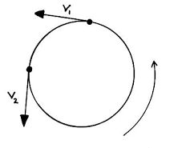
Representation of circular motion

Slide 4
UNIFORM CIRCULAR MOTION
The definition of uniform circular motion is that body moves around a fixed point or on a circular track with uniform speed.
When an object is in uniform circular motion, its speed doesn't change. It means that an object will move with constant speed.

Slide 5
What is uniform circular motion with example?
Uniform circular motion is a specific type of motion in which an object travels in a circle with a constant speed.
For example, any point on a propeller spinning at a constant rate is executing uniform circular motion.
Other examples are the second, minute, and hour hands of a watch.

Slide 6
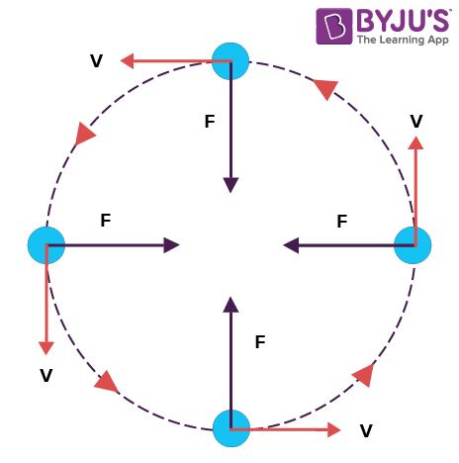
Representation of uniform circular motion

Slide 7
What causes uniform circular motion?
The direction of the net force is in the same direction as the acceleration. So for an object moving in a circle, there must be an inward force acting upon it in order to cause its inward acceleration. This is sometimes referred to as the centripetal force requirement.

Slide 8
What is the formula of uniform circular motion?
The radial acceleration can also be expressed with the help of the period of the motion i.e. T.
This period T is the amount of time taken to complete a revolution.
Its unit is seconds.
The circumference of the circle is equal to pi Π multiplied by the radius R.

Slide 9
Cont..

Slide 10
What are the characteristics of uniform circular motion?
It is a periodic motion with definite period and frequency.
Speed of particle remains constant but velocity changes continuously.
It is an accelerated motion.
Work done in one period of U.C.M is zero.
The direction of motion in circular path continually changes.
For example: An athlete running on the circular path with constant speed has changing velocity since the direction of motion is changing. When the body moves in a circular path with uniform speed, it is called uniform circular motion.

Slide 11
Is acceleration uniform in uniform circular motion?
Acceleration is a change in velocity, either in its magnitude—i.e., speed—or in its direction, or both. In uniform circular motion, the direction of the velocity changes constantly, so there is always an associated acceleration, even though the speed might be constant.

Slide 12
What changes continuously in uniform circular motion?
The direction changes continuously in uniform circular motion.
Since the direction changes, velocity too changes.
The moving object always tries to face towards the center.
The magnitude of uniform circular motion remains constant.

Slide 13
Why uniform circular motion is called accelerated motion?
Uniform circular motion is accelerated because the velocity changes due to continuous change in the direction of motion. ... Thus, for a body moving in a circular path at a constant speed, its velocity changes continuously. The change in velocity gives rise to an acceleration in the moving body.

Slide 14
What is the difference between circular motion and uniform circular motion?
When a body moves in a circular path with uniform speed or constant speed, its motion is known as Uniform Circular motion.
But the velocity of the body moving in a circle with uniform speed is not uniform because the direction of motion is constantly changing.

Slide 15
What is non uniform circular motion?
In non-uniform circular motion, an object's motion is along a circle, but the object's speed is not constant.
The object's velocity vector is always tangent to the circle. The speed and angular speed of the object are not constant.

Slide 16
What is the difference between uniform circular motion and non uniform circular motion?
The uniform circular motion, which is a circular motion with constant speed while non-uniform circular motion denotes a change in the speed of the particle moving along the circular path.

